Slide 1

Chapter 19 Java Data Structures
The limitations of arrays
Java Collection Framework hierarchy
Use the Iterator interface to traverse a collection
Set interface, HashSet, and TreeSet
List interface, ArrayList, and LinkedList
Vector and Stack
Map, HashMap, and TreeMap
Collections and Arrays classes

Slide 2
Limitations of arrays
Once an array is created, its size cannot be altered.
Array provides inadequate support for inserting, deleting, sorting, and searching operations.

Slide 3
Java Collection Framework hierarchy
A collection is an object that represents a group of objects, often referred to as elements. The Java Collections Framework supports two types of collections, named collections and maps.

Slide 4
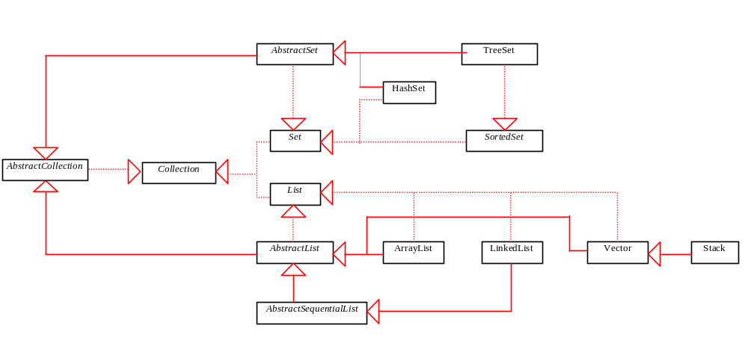
Java Collection Framework hierarchy, cont.
A collection can be a set or a list, defined in the interfaces Set and List, which are subinterfaces of Collection.

Slide 5
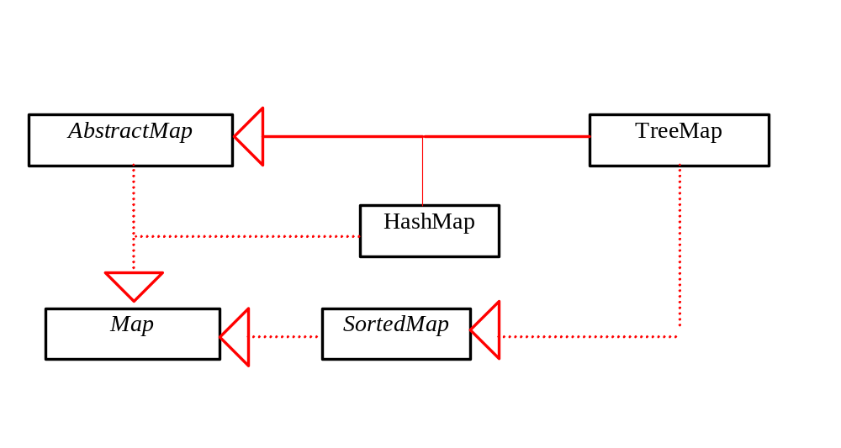
Java Collection Framework hierarchy, cont.
An instance of Map represents a group of objects, each of which is associated with a key. You can get the object from a map using a key, and you have to use a key to put the object into the map.

Slide 6
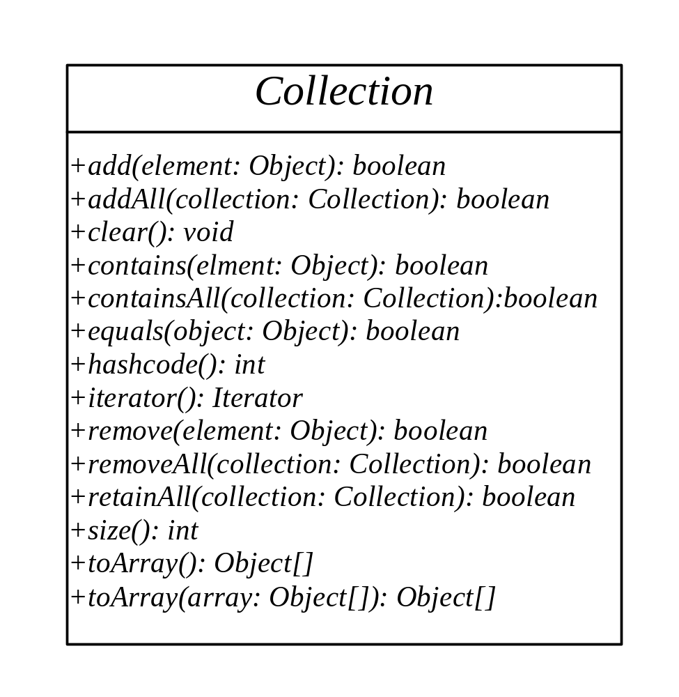
The Collection Interface
The Collection interface is the root interface for storing and processing a collection of objects.

Slide 7
The hashCode Method and the equals Method
The hashCode method and the equals method are defined in the Object class as well as in the Collection interface. The contract of hashCode (equals) in the Object class is the same as the one in the Collection interface.
A class that implements the Collection interface does not have to implement the hashCode method and the equals method, because both methods have default implementation in the Object class.

Slide 8
The hashCode Method and the equals Method, cont.
What are the benefits of defining hashCode and equals in both Object class and the Collection interface? I think the benefits are to facilitate generic programming. For instance, you may have a method with a parameter of the Collection type. This parameter can use the hashCode method and the equals method since the methods are in the Collection interface.

Slide 9
The Set Interface
The Set interface extends the Collection interface. It does not introduce new methods or constants, but it stipulates that an instance of Set contains no duplicate elements. The concrete classes that implement Set must ensure that no duplicate elements can be added to the set. That is no two elements e1 and e2 can be in the set such that e1.equals(e2) is true.

Slide 10
The AbstractSet Class
The AbstractSet class is a convenience class that extends AbstractCollection and implements Set. The AbstractSet class provides concrete implementations for the equals method and the hashCode method. The hash code of a set is the sum of the hash code of all the elements in the set. Since the size method and iterator method are not implemented in the AbstractSet class, AbstractSet is an abstract class.

Slide 11
The HashSet Class
The HashSet class is a concrete class that implements Set. It can be used to store duplicate-free elements. For efficiency, objects added to a hash set need to implement the hashCode method in a manner that properly disperses the hash code.

Slide 12
Example 19.1 Using HashSet and Iterator
This example creates a hash set filled with strings, and uses an iterator to traverse the elements in the list.
Execute the TestHasSet.java example

Slide 13
The SortedSet Interface and the TreeSet Class
SortedSet is a subinterface of Set, which guarantees that the elements in the set are sorted. TreeSet is a concrete class that implements the SortedSet interface. You can use an iterator to traverse the elements in the sorted order. The elements can be sorted in two ways.

Slide 14
The SortedSet Interface and the TreeSet Class, cont.
One way is to use the Comparable interface.
The other way is to specify a comparator for the elements in the set if the class for the elements does not implement the Comparable interface, or you don’t want to use the compareTo method in the class that implements the Comparable interface. This approach is referred to as order by comparator.

Slide 15
Example 19.2 Using TreeSet to Sort Elements in a Set
This example creates a hash set filled with strings, and then creates a tree set for the same strings. The strings are sorted in the tree set using the compareTo method in the Comparable interface. The example also creates a tree set of geometric objects. The geometric objects are sorted using the compare method in the Comparator interface.
Try the GeometricObjectCopmarator.java and the TestTreeSet.java files.

Slide 16
The List Interface
A set stores non-duplicate elements. To allow duplicate elements to be stored in a collection, you need to use a list. A list can not only store duplicate elements, but can also allow the user to specify where the element is stored. The user can access the element by index.

Slide 17
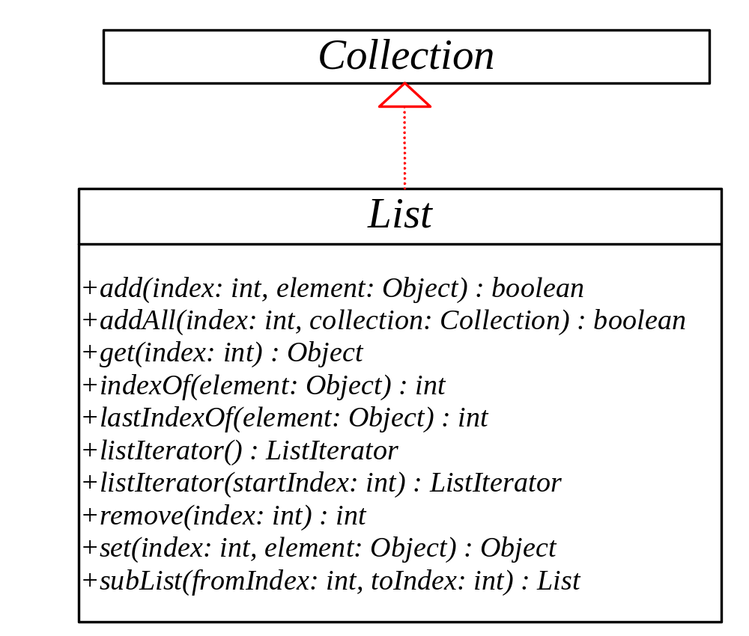
The List Interface, cont.

Slide 18
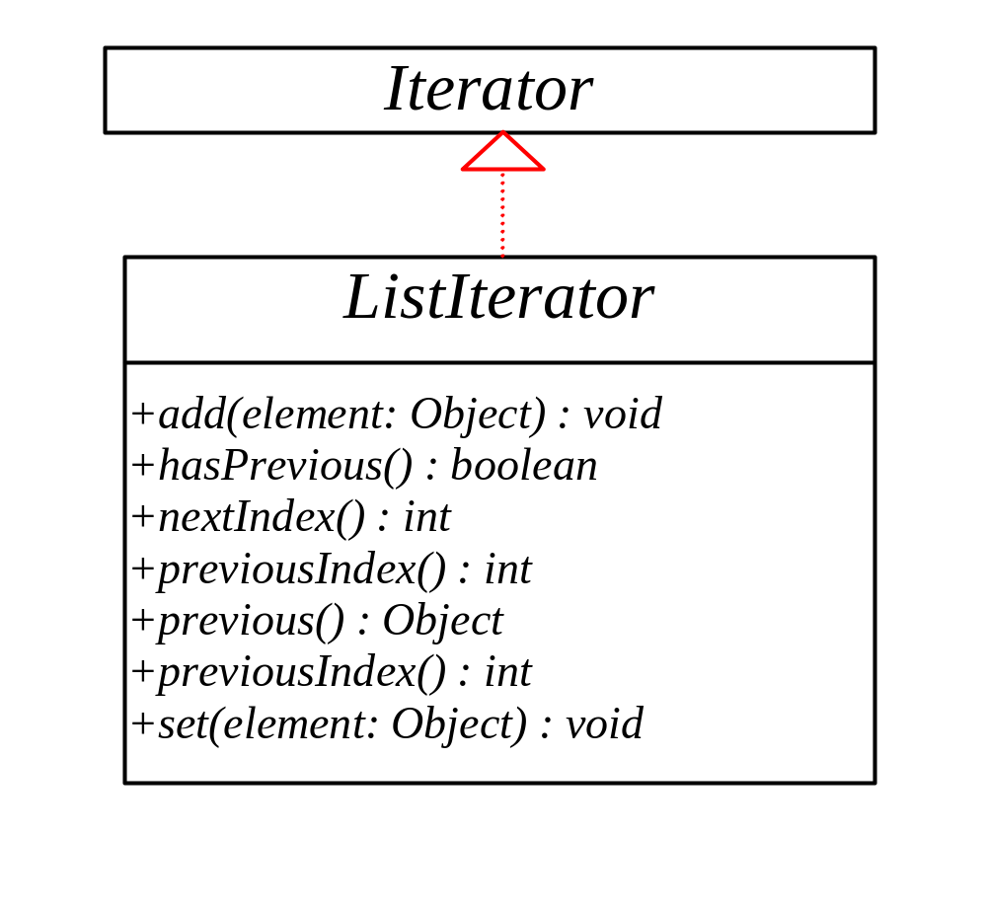
The List Iterator

Slide 19
ArrayList and LinkedList
The ArrayList class and the LinkedList class are concrete implementations of the List interface. Which of the two classes you use depends on your specific needs. If you need to support random access through an index without inserting or removing elements from any place other than the end, ArrayList offers the most efficient collection. If, however, your application requires the insertion or deletion of elements from any place in the list, you should choose LinkedList. A list can grow or shrink dynamically. An array is fixed once it is created. If your application does not require insertion or deletion of elements, the most efficient data structure is the array.

Slide 20
Example 19.3 Using ArrayList and LinkedList
This example creates an array list filled with numbers, and inserts new elements into the specified location in the list. The example also creates a linked list from the array list, inserts and removes the elements from the list. Finally, the example traverses the list forward and backward.
Check the TestList.java example

Slide 21
The Vector and Stack Classes
The Java Collections Framework was introduced with Java 2. Several data structures were supported prior to Java 2. Among them are the Vector class and the Stack class. These classes were redesigned to fit into the Java Collections Framework, but their old-style methods are retained for compatibility. This section introduces the Vector class and the Stack class.

Slide 22
The Vector Class
In Java 2, Vector is the same as ArrayList, except that Vector contains the synchronized methods for accessing and modifying the vector. None of the new collection data structures introduced so far are synchronized. If synchronization is required, you can use the synchronized versions of the collection classes. These classes are introduced later in the section, “The Collections Class.”

Slide 23
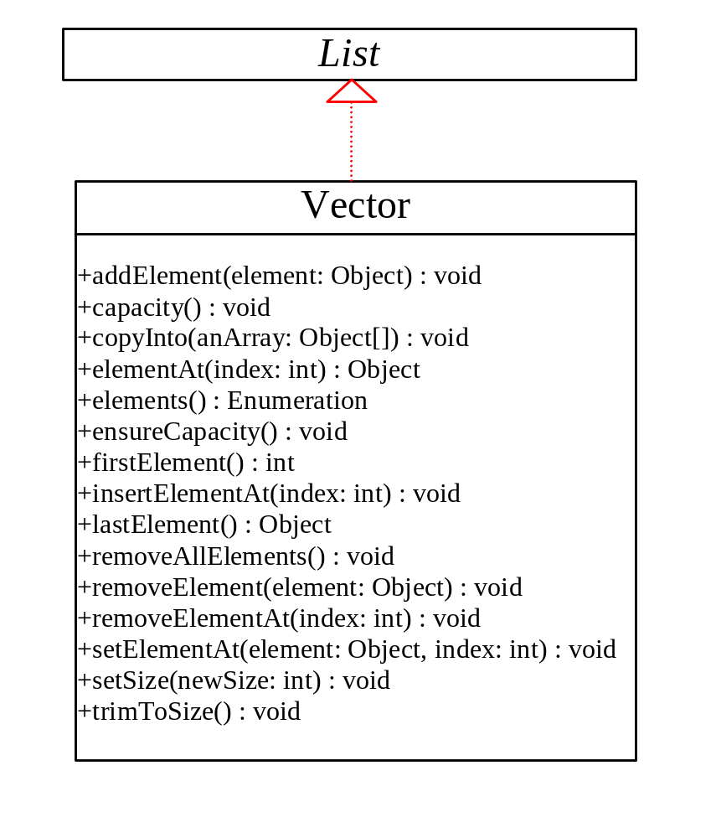
The Vector Class, cont.

Slide 24
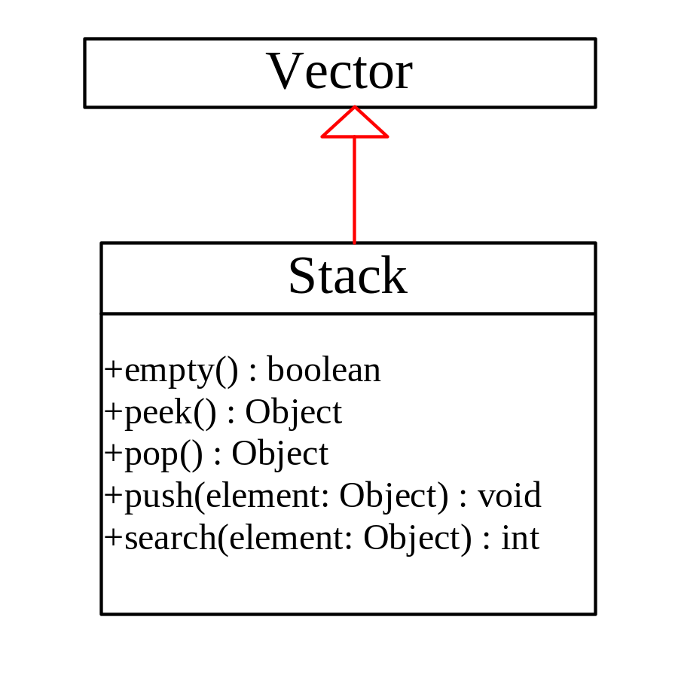
The Stack Class
The Stack class represents a last-in-first-out stack of objects. The elements are accessed only from the top of the stack. You can retrieve, insert, or remove an element from the top of the stack.

Slide 25
Example 19. 4 Using Vector and Stack
This example presents two programs to rewrite Example 5.2, using a vector and a stack instead of an array, respectively. The program reads student scores from the keyboard, stores the scores in the vector, finds the best scores, and then assigns grades for all the students. A negative score signals the end of the input.
Check the AssignGradeUsingVector.java example.

Slide 26
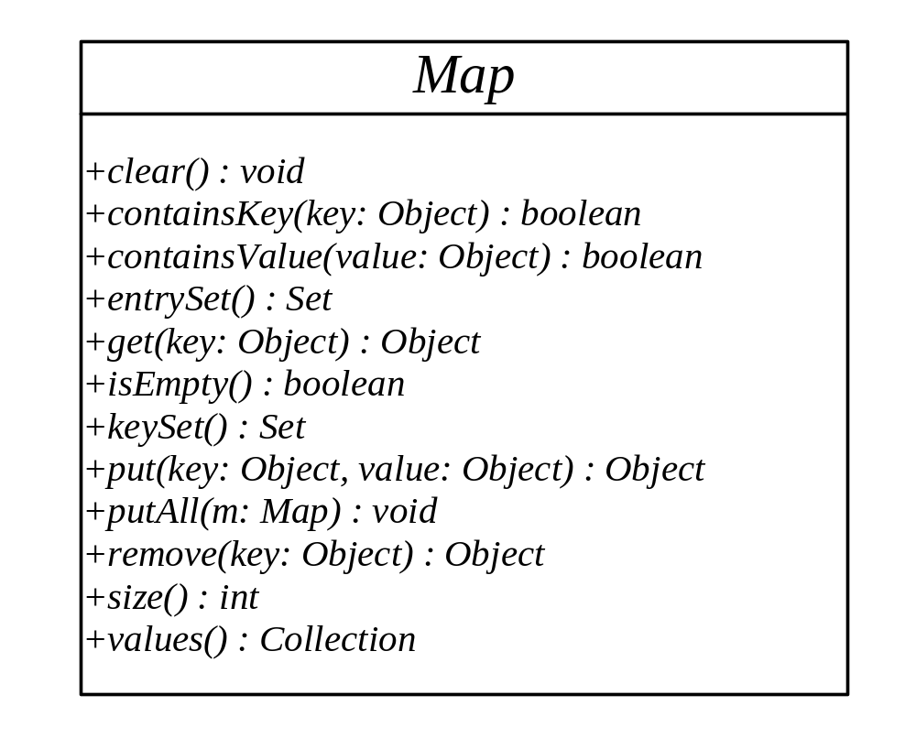
The Map Interface
The Map interface maps keys to the elements. The keys are like indexes. In List, the indexes are integer. In Map, the keys can be any objects.

Slide 27
HashMap and TreeMap
The HashMap and TreeMap classes are two concrete implementations of the Map interface. The HashMap class is efficient for locating a value, inserting a mapping, and deleting a mapping. The TreeMap class, implementing SortedMap, is efficient for traversing the keys in a sorted order.

Slide 28
Example 19.5 Using HashMap and TreeMap
This example creates a hash map that maps borrowers to mortgages. The program first creates a hash map with the borrower’s name as its key and mortgage as its value. The program then creates a tree map from the hash map, and displays the mappings in ascending order of the keys.
Check the TestMap.java example

Slide 29
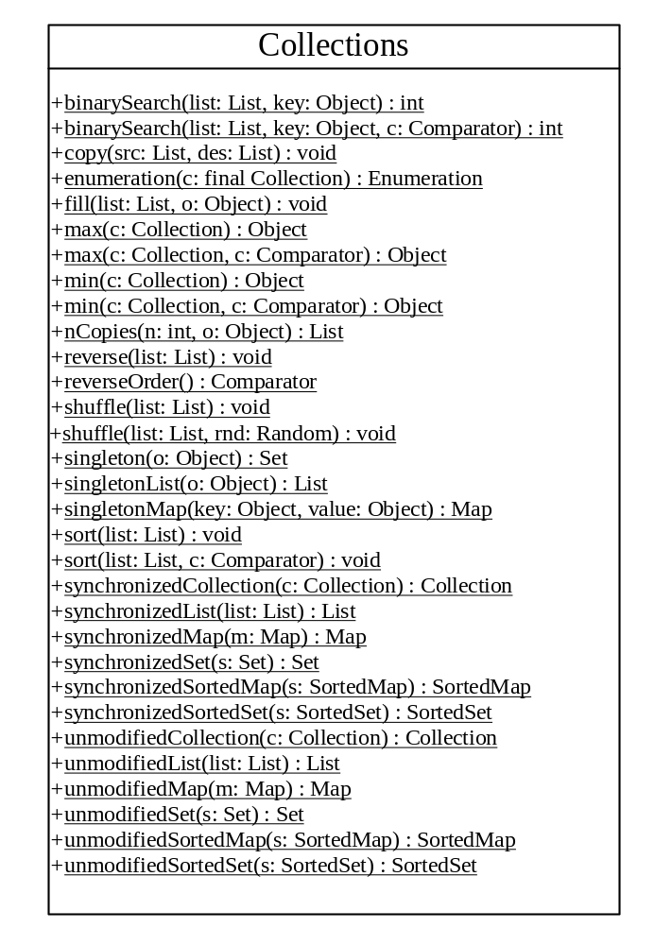
The Collections Class
The Collections class contains various static methods for operating on collections and maps, for creating synchronized collection classes, and for creating read-only collection classes.

Slide 30
Example 19. 6 Using the Collections Class
This example demonstrates using the methods in the Collections class. The example creates a list, sorts it, and searches for an element. The example wraps the list into a synchronized and read-only list.
Check the TestCollections.java example

Slide 31
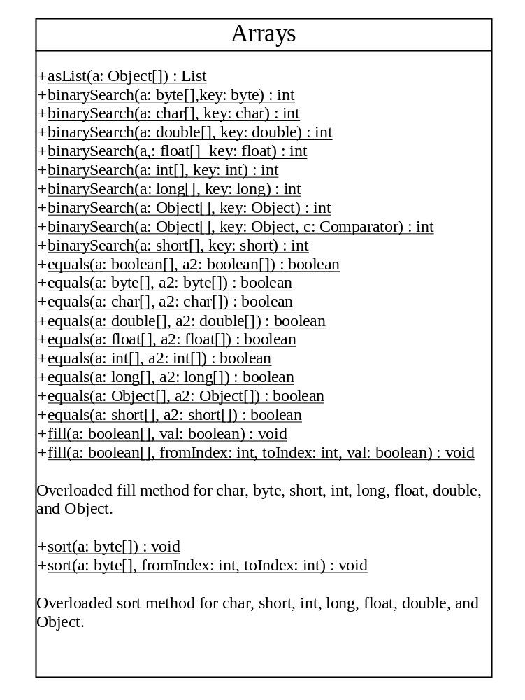
The Arrays Class
The Arrays class contains various static methods for sorting and searching arrays, for comparing arrays, and for filling array elements. It also contains a method for converting an array to a list.

Slide 32
Example 19. 7 Using the Arrays Class
This example demonstrates using the methods in the Arrays class. The example creates an array of int values, fills part of the array with 50, sorts it, searches for an element, and compares the array with another array.
Check the TestArrays.java example

